Slide 1
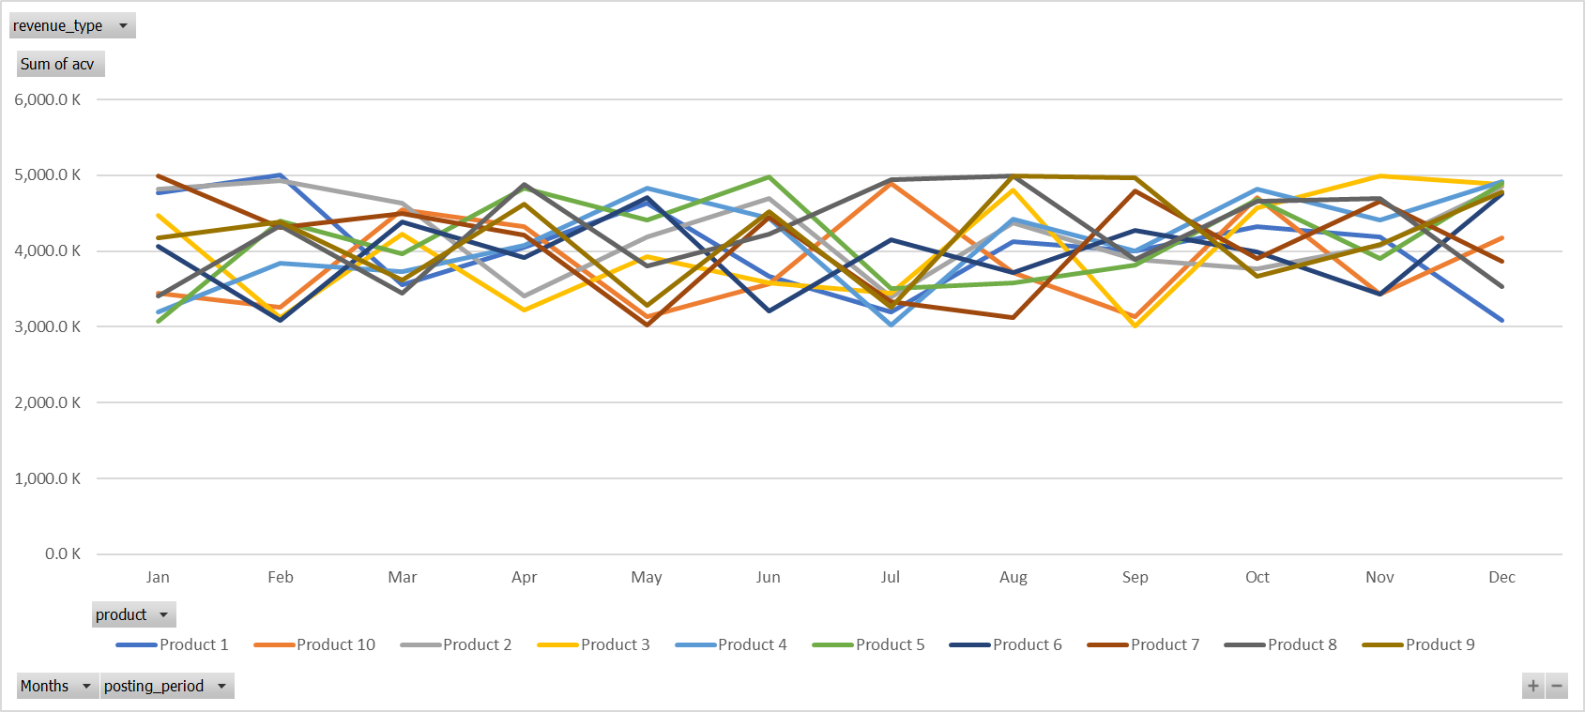

All Revenue Type
Hi John Doe
S No. | Line of Business | Revenue Type | Product | Posting Period | ACV | TCV | Revenue
1 | Lob 1 | Revenue type 2 | Product 1 | Jan-19 | $ 4,763.6 K | $ 3,486.7 K | $ 4,348.2 K
2 | Lob 2 | Revenue type 1 | Product 2 | Jan-19 | $ 4,817.6 K | $ 4,950.0 K | $ 4,079.5 K
3 | Lob 3 | Revenue type 3 | Product 3 | Jan-19 | $ 4,475.5 K | $ 4,950.2 K | $ 4,007.5 K
4 | Lob 1 | Revenue type 2 | Product 4 | Jan-19 | $ 3,196.7 K | $ 5,330.1 K | $ 4,519.3 K
5 | Lob 2 | Revenue type 1 | Product 5 | Jan-19 | $ 3,076.7 K | $ 5,312.1 K | $ 4,457.6 K
6 | Lob 3 | Revenue type 3 | Product 6 | Jan-19 | $ 4,067.8 K | $ 5,167.5 K | $ 4,104.3 K
7 | Lob 1 | Revenue type 2 | Product 7 | Jan-19 | $ 4,996.6 K | $ 5,769.8 K | $ 4,445.0 K
8 | Lob 2 | Revenue type 1 | Product 8 | Jan-19 | $ 3,412.6 K | $ 3,378.9 K | $ 4,592.0 K
9 | Lob 3 | Revenue type 3 | Product 9 | Jan-19 | $ 4,176.0 K | $ 4,251.7 K | $ 4,404.7 K
10 | Lob 3 | Revenue type 3 | Product 10 | Jan-19 | $ 3,442.2 K | $ 3,627.8 K | $ 4,002.1 K

